Slide 1
STUDENT ORIENTATION Trimester 1, 2022
A very warm welcome to our New Students from the UBSS Staff.
“We acknowledge the Warundjeri people of the Kulin Nation, the traditional custodians of this land and pay respects to the Elders both past and present.”

Slide 2
Today’s Topics
Welcome message
Introduction to UBSS
Living in Australia
Living in Melbourne
Our Melbourne CBD Campus
Facilities and Resources
Support Services
Skills Development
Important Procedures
Compliance
Policies and Procedures

Slide 3
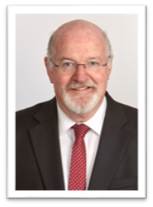
Welcome Message
Student success at UBSS is supported by a world class team of mostly PhD specialised academics and student support staff.
We are committed to students seeking to build or further their business leadership and accounting careers, based on an international education with an Australian experience, leading edge innovation and digital technology for those who want to be job ready when they graduate.
Set in the heart of Melbourne's education precinct, UBSS Melbourne CBD Campus offers students more than world class education. It is also surrounded by a bustling, cosmopolitan, inner city dining and shopping experience, only metres from the Melbourne Town Hall. With multiple tram routes also accessing the campus, students are assured of safe and reliable transport options. We look forward to welcoming you and supporting your career success.
We are currently limited to a virtual campus at present – but we are hopeful to resume an onsite presence n the not too distant future.
Emeritus Professor Greg Whateley
GCA Deputy Vice Chancellor
Provost, UBSS Melbourne Campus

Slide 4
Introduction to UBSS
UBSS is a nationally recognised business school and higher education provider of undergraduate and postgraduate programs that prepare you for the challenges of the global business marketplace.
Our Programs
Bachelor of Accounting
Bachelor of Business
Master of Business Administration (MBA)
Accounting
Entrepreneurship
Source: The Australian Government Department of Education and Training Quality Indicators for Learning and Teaching - qilt.edu.au

Slide 5
Introduction to UBSS
UBSS Mission
UBSS launches careers for the entrepreneurs of the future
UBSS Motto
"International Education with an Australian Experience"
UBSS Values
Delivering the Bachelor of Business, Bachelor of Accounting and MBA with an Australian experience
Providing a learning environment for the entrepreneurs of the future
Providing a high level of student support and care to deliver a quality learning space
Providing access to cutting edge online and classroom education technology for all students
Ensuring academic excellence & free intellectual Inquiry

Slide 6
UBSS Governance
UBSS is a member of Group Colleges Australia (GCA), a consortium of educational institutions based in Australia.
The GCA Board and the GCA Executive Management Team have ultimate responsibility for UBSS performance and operations as an accredited higher education provider.
Overview of UBSS is managed by the UBSS Senior Executive in association with the UBSS Academic Senate.
Governance and Leadership
https://www.ubss.edu.au/about-us/?tab=Governance

Slide 7
UBSS Registration
UBSS is registered as a higher education provider in Australia by the Tertiary Education Quality and Standards Agency (TEQSA). The Tertiary Education Quality and Standards Agency (TEQSA), registers all Australian institutions, including government and private universities, that offer courses at the higher education (tertiary level) and accredits their courses for delivery in Australia and/or offshore locations.
CRICOS is the Commonwealth Register of Institutions and Courses for Overseas Students. CRICOS registration means that UBSS is authorised by the Australian government to enrol international students in its courses.
When you attend university or an approved higher education provider, you can get a FEE-HELP loan to pay all or part of your tuition fees (for Australian citizens and some special New Zealand visa holders only).
Registration and Accreditation
https://www.ubss.edu.au/registration-and-accreditation/

Slide 8
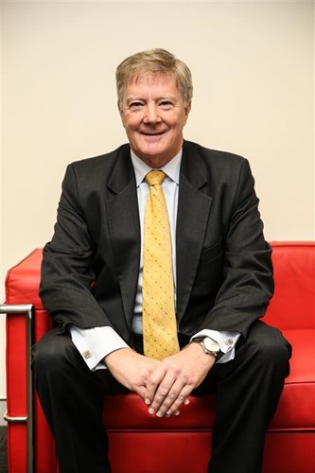
UBSS Founder – Alan Manly
Alan Manly OAM JP, FAICD, FIML
Alan is a published author, company director and entrepreneur with over thirty years of experience in the technology and education industries.
He is a founding Director and Chief Executive Officer of the GCA group of companies.
As Chief Executive Officer he is responsible for the corporate planning and governance of the group which is includes a Independent Higher Education Institute, Universal Business School Sydney, (UBSS) which offers a Business Degree, an Accounting Degree and a Masters of Business Administration.
Alan has been honoured in the Queen’s Birthday 2021 Honours List with the Medal of the Order of Australia (OAM) General Division. The honour is bestowed in appreciation of Alan’s service to tertiary education. The citation also acknowledges his commitment to community service over a number of years.
https://www.ubss.edu.au/ubss-founder-alan-manly/
“If you are to compare an institution run by a government department with one that might have the soul of an entrepreneur, there’s a pretty obvious differentiator there. That’s what we wish to promote at UBSS.”
- Alan Manly, CEO Magazine, September 2016

Slide 9
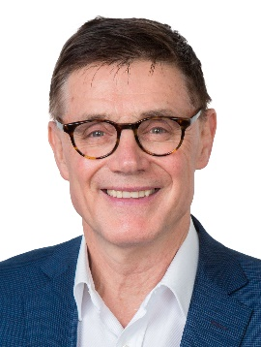
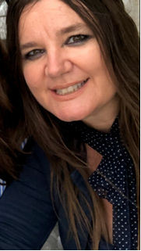
Key UBSS Melbourne Staff
Emeritus Professor Greg Whateley
GCA Deputy Vice Chancellor
Provost, UBSS Melbourne Campus
Greg.Whateley@ubss.edu.au
Associate Professor Cyril Jankoff
Programs Director, UBSS Melbourne Campus
Cyril.Jankoff@ubss.edu.au
Assistant Professor Veronica Sorace
Learning and Student Support Co-ordinator
veronica.sorace@ubss.edu.au

Slide 10
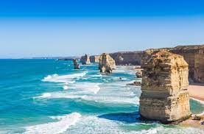
Living in Australia
"Australia is a stable, democratic and culturally diverse nation with a highly skilled workforce and one of the strongest performing economies in the world.” https://www.ubss.edu.au/living-in-australia/
Global Recognition Growing Destination Multicultural Society
Safe Environment Cost of Living Work

Slide 11
Living in Australia
While living in Australia there are also a couple of important things to keep in mind:
Emergency Contacts: Triple Zero (000) is only to be used in a life threatening or critical situation when contacting the Police, Ambulance or Fire Services. Calls to Triple Zero (000) are FREE.
International Student Safety: https://www.safeworkaustralia.gov.au/ covid-19-information-workplaces/industry-information/public-transport
Beach Safety: https://www.healthdirect.gov.au/beach-safety
Overseas Student Health Cover: https://oshcaustralia.com.au/en
Legal Advice: http://www.study.sydney/live/support-services

Slide 12
Living in Melbourne
“Melbourne is the capital city of Victoria and one of the southern hemisphere’s largest business, cultural, sporting and recreational cities. People living in Melbourne enjoy a safe city, affordable healthcare, world-class education, reliable infrastructure, business opportunities and a healthy environment”
https://liveinmelbourne.vic.gov.au/discover

Slide 13
Living in Melbourne
Places to Explore
“ Melbourne’s unique climate has something for everyone – summers that are warm, autumns that are moderate, winters that are cool, and springs that are sunny and bright. There are also great activities to enjoy.”
https://liveinmelbourne.vic.gov.au/discover/things-to-do-in-melbourne
Cost of Living - Rent (or other accommodation), utilities, groceries, restaurants and transport. Students should be aware that the costs of studying in Australia will depend on your education provider, the level of study you choose and your study location in Australia.
https://www.studyinaustralia.gov.au/english/live-in-australia/living-costs

Slide 14
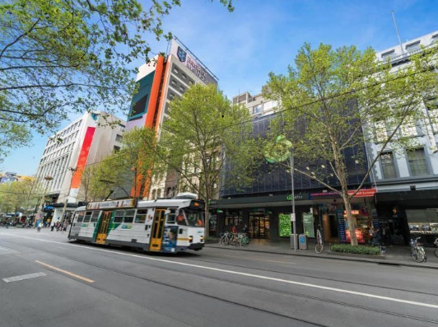
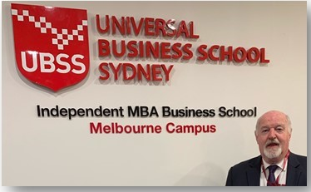
Our Melbourne CBD Campus
“The CBD is your campus”
The UBSS Melbourne CBD campus is in the heart of the Melbourne CBD just doors up from The Melbourne Town Hall and intersecting both Bourke Street and Collins Street
Level 2, 158 Swanston Street
Melbourne VIC 3000
Australia

Slide 15
Our Melbourne CBD Campus
Security
UBSS Melbourne CBD Campus has 24/7 security cameras to ensure your safety on campus.
DO NOT leave your belongings unattended anywhere.
Health
For all health related matters you can visit the nearest medical centre, Swanston Street Medical Centre.
Telephone: +61 3 9205 7500
Address: Level 3, 255 Bourke Street Melbourne VIC 3000

Slide 16
First Aid
All programs are currently being delivered online, we will inform you of further details once face-to-face classes are back.

Slide 17
Hygiene on Campus

Slide 18
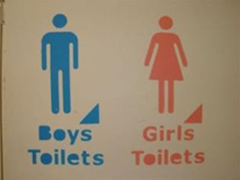
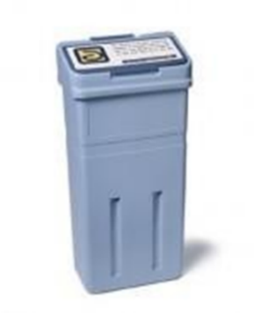
Hygiene on Campus
Students are to keep bathrooms clean and tidy.
Consider others – clean up after yourselves.

Slide 19
Campus Evacuation Procedure
All programs are currently being delivered online, we will inform you of further details once face-to-face classes are back.

Slide 20
3. Life on Campus
Our Melbourne CBD Campus
UBSS Student Central
Easy access to all your student resources.
https://www.ubss.edu.au/student-central/

Slide 21
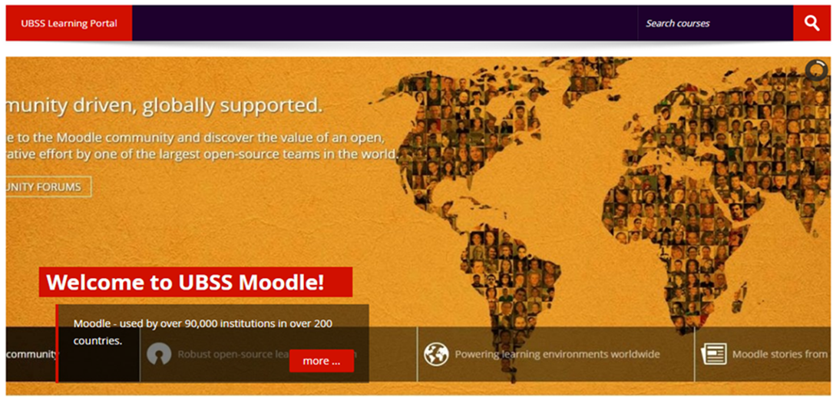
Facilities & Resources - Moodle
Moodle is a learning platform designed to provide educators, administrators and learners with a single robust, secure and integrated system to create personalised learning environments.

Slide 22
Facilities & Resources - Moodle
Moodle will give you access to:
Subject outlines
Readings and recordings
Submission of assignments
Grades and marks
Moodle can be accessed through your Student Central found on the UBSS website.
https://www.ubss.edu.au/student-central/

Slide 23
Facilities & Resources - myGCA
myGCA Connect enhances the entire student experience with user-friendly online educational tools that streamline and automate everyday tasks, and provides a collaborative ecosystem for students.

Slide 24
Facilities & Resources - myGCA
myGCA will give you access to:
Your student information (please make sure your contact details are up-to-date)
Academic Certificates and academic progress
Support Services (leave, deferment and study load applications among other services)
Financial Status (make tuition fee payments online)
Subject selection and timetables and much more.
myGCA can be accessed through your Student Central found on the UBSS website.
https://www.ubss.edu.au/student-central/

Slide 25
Facilities & Resources – elibraries
Complete and optimized research solution.
https://www.ubss.edu.au/e-libraries/

Slide 26
Facilities & Resources – Communication
Effective communication between UBSS and students is VERY important.
Like all large educational institutions in Australia, UBSS uses technology to communicate with students.
There are 5 main ways of communicating with you:
myGCA Bulletin: bulletins are sent out so you don’t miss anything important. They will automatically appear once you log into your myGCA account.
GCA Webmail: all students have an email account (studentID@studentmail.gca.edu.au).
SMS to mobile: text messages are sometimes sent for urgent messaging.
UBSS Mobile App: we might send you notifications via your UBSS Mobile App, so make sure you download it.
TV Monitors: these are placed all over campus to provide you with student information and occasionally some “words of wisdom”.
Online Surveys: we like to hear from you. Through our online surveys we manage student satisfaction and feedback.

Slide 27
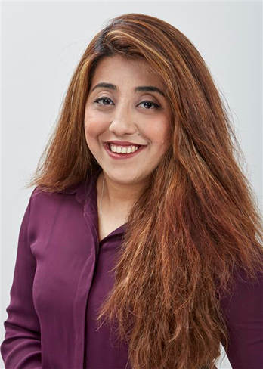
Support Services
GCA Support Staff
Sumera Qasim Manager, Student Services Sumera.Qasim@gca.edu.au
Assistant Professor Veronica Sorace
Learning and Student Support Coordinator
veronica.sorace@ubss.edu.au

Slide 28
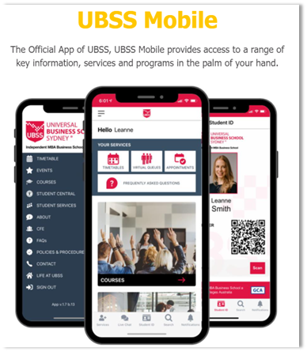
Support Services
UBSS Mobile App
Via the UBSS App students are able to:
Check their timetables and schedule
Book appointments with UBSS staff
Live chat
Follow up on UBSS events
Check available courses
Gain access to the “Student Central”
View Frequently Asked Questions (FAQs)
View Policies and Procedures
29

Slide 29
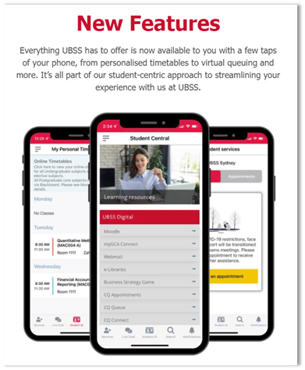
New improved features include:
Access to MyGCA Connect
Digital student card
IMPORTANT:
Upcoming events & important dates to be communicated ONLY via the app
30

Slide 30
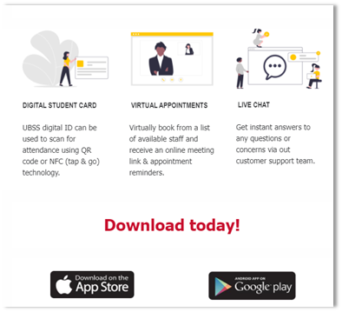
31

Slide 31
Support Services
CQ Queue Management System
UBSS utilises the CQ Queue Management System which allows students to:
• Take virtual tickets to join the Student Services queue
• Receive notifications when their ticket is about to be called
• Book appointments to see UBSS staff.

Slide 32
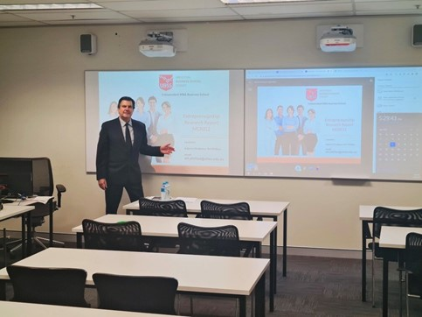
Support Services
State-of-the-Art Online Education Facilities
Lecture Studios live broadcast of a lecture room for a richer and more advanced online student experience. All Lecture studios feature the following technologies:
• High definition automatic tracking cameras.
• High quality dual-channel wireless microphones.
• Dual interactive whiteboards.
• Dual display screens for more effective classroom management.
• Wireless presenter remotes.

Slide 33
Skills Development
Centre for Entrepreneurship
https://www.ubss.edu.au/centre-for-entrepreneurship/
Welcome to the Centre for Entrepreneurship (CFE) - disrupting the higher education agenda. Where students have an immediate exposure to highly acclaimed entrepreneurs and organisations, directly involved in business in Australia.

Slide 34
Skills Development
The Business Strategy Game (BSG)
What Is The Business Strategy Game?
The Business Strategy Game is an online exercise where class members are divided into teams and assigned the task of running an athletic footwear company in head-to-head competition against companies managed by other class members.
Your company will also compete online against companies managed by other students from
world-renowned universities and business schools around the world.
UBSS students have an outstanding performance
and recently one group reached #1 in the world!!

Slide 35
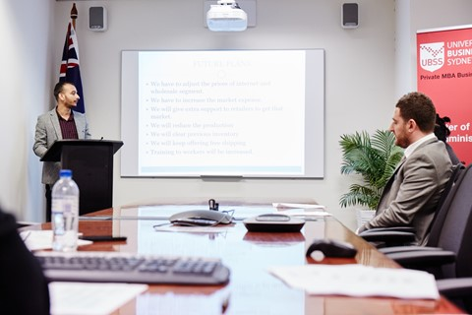
Skills Development
Capstone Project
https://www.ubss.edu.au/centre-for-entrepreneurship/
“It is a multi-faceted project that serves as a culminating academic and intellectual experience for students.”

Slide 36
Important Procedures – Student ID Cards
Student Identification During the registration process you will be prompted to upload your ID photo.
You will have access to the digital student ID card on the UBSS Mobile App.
Please download your UBSS Mobile App today.
https://www.ubss.edu.au/ubss-mobile/?tab=Overview

Slide 37
Academic Matters
Important Procedures – Subject Selection
Log into your myGCA account today and select your subjects.
Visit the UBSS website for more information on Subject Selection and Courses.
https://www.ubss.edu.au/subject-selection
https://www.ubss.edu.au/courses/
Step 1: Log into your myGCA student account
Step 2: On your Student Home Page, click on Student Services Online
Step 3: Click on Subject Selection

Slide 38
Academic Matters
Important Procedures – Credit and Recognition of Prior Learning
Credit and Recognition of Prior Learning is where you receive recognition for previous study where that study is the same as the course you are going to be doing.
To be eligible for Recognition of Prior Learning (RPL), some conditions need to be met. The previous study must have:
Same/similar content
Same/similar duration
Same/similar level of institution, i.e higher education/university or vocational education at an appropriate level of study.
Application must be made by end of Week 2 of the beginning of your first trimester of study.
Granting credit for courses that are unrelated to the course for which you are enrolled will not receive the same amount of credit as a related course.

Slide 39
Academic Matters
Important Procedures – Credit and Recognition of Prior Learning
How to apply for Recognition of Prior Learning?
Step 1: Log into your myGCA student account
Step 2: On your Student Home Page, click on Student Services Online
Step 3: Click on Support Services and then “Credit and Recognition of Prior Learning”.
Credit is granted for students on an individual basis; based on the UBSS Credit and Recognition of Prior Learning Policy found here: https://www.ubss.edu.au/policies-and-procedures

Slide 40
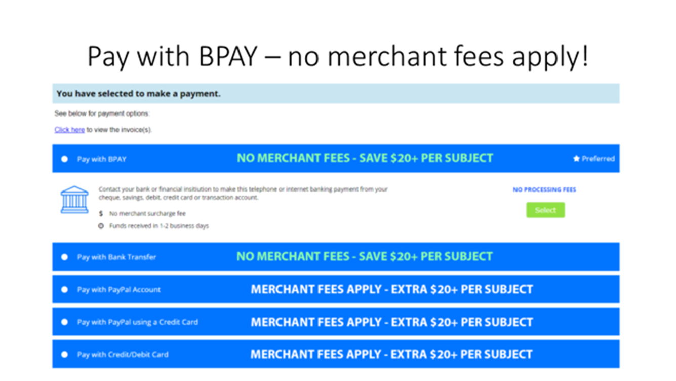
Important Procedures – Paying your Tuition Fees
BPAY – the preferred payment option for UBSS

Slide 41
Important Procedures – Paying your Tuition Fees
How to make a payment?
Step 1: Log into your myGCA student account
Step 2: On your Student Home Page, click on Student Services Online
Step 3: Click on Financial Status
Step 4: On you Account Summary click on Make Payment or Payment and Receipt details and follow instructions.

Slide 43
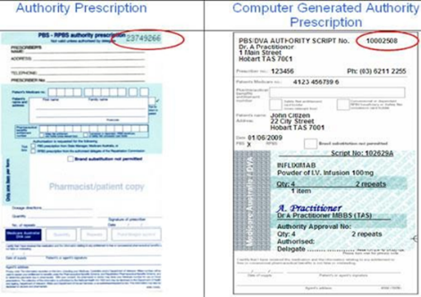
Important Procedures – Medical Leave
Apply for Medical Leave via MyGCA / Student Services Online / Support Services / Approved Leave When you visit your Doctor ask for a medical certificate. Doctors are registered with the Australian government and will have a Medicare Provider Number.
UPLOAD YOUR MEDICAL CERTIFICATE and other documents where applicable.
You must keep the original of all medical documents. DHA may wish to view the document.

Slide 44
Important Procedures – Refund & Cancellation
The Refund and Cancellation Policy is outlined in your Offer Letter. For more details refer to:
GCA Refund Policy
https://www.gca.edu.au/Uploads/files/GCA%20Refund%20Policy%20v12%202019.pdf
Information on Student Tuition Protection Scheme
https://www.ubss.edu.au/tuition-protection-service/

Slide 45
Sexual Assault & Sexual Harrassment
UBSS prides itself on creating a safe environment for the student community. If an incident were to occur on the premises during class hours inform your teacher and/or contact the following Staff-
https://www.gca.edu.au/Uploads/files/GCA%20Sexual%20Misconduct%20Prevention%20and%20Response%20Policy%20v1(1).pdf

Slide 46
Counselling
Are you having personal problems? Do you need to talk to someone?
GCA suggests …
Contact Overseas Student Health Cover (OSHC) Refer Slide 11 or call
Lifeline 13 11 14
Beyond Blue 1300 22 4636
45

Slide 47
Holidays
End of trimester holidays are listed on your Academic Calendar available on the UBSS Student Central website.
https://www.ubss.edu.au/academic-calendar/
If you would like to apply for holidays during your regular study periods you will need to apply for a deferment (3 month leave). For more information about this, please see our Deferment Policy.
https://www.ubss.edu.au/policies-and-procedures/?tab=Policies%20and%20Procedures
Please send all Deferment enquiries to Madilina.Tresca@ubss.edu.au

Slide 48
Places of Worship
There are no prayer rooms on campus. Please visit the link below to find places of worship near the campus.
https://www.melbourne.vic.gov.au/sitecollectiondocuments/melbourne_city_map.pdf
Christianity
Islam
Baháʼí
Buddhism
Judaism
Hinduism
Sikhism
Shinto
Taoism
Zoroastrianism

Slide 49
Compliance (DHA)
Department of Home Affairs (DHA)
DHA deals with:
Students visas
Student visa holders monitoring
DHA is interested in:
Your academic progress
Where you live (via your myGCA account)
Your employment
Important: Group Colleges Australia / UBSS have a legal responsibility to report students who do not meet the DHA requirements.

Slide 50
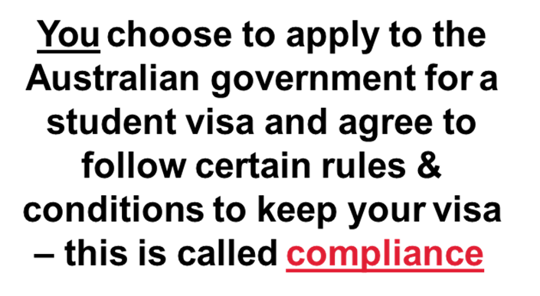
Compliance (DHA)

Slide 51
What are your rights at work?

Slide 52
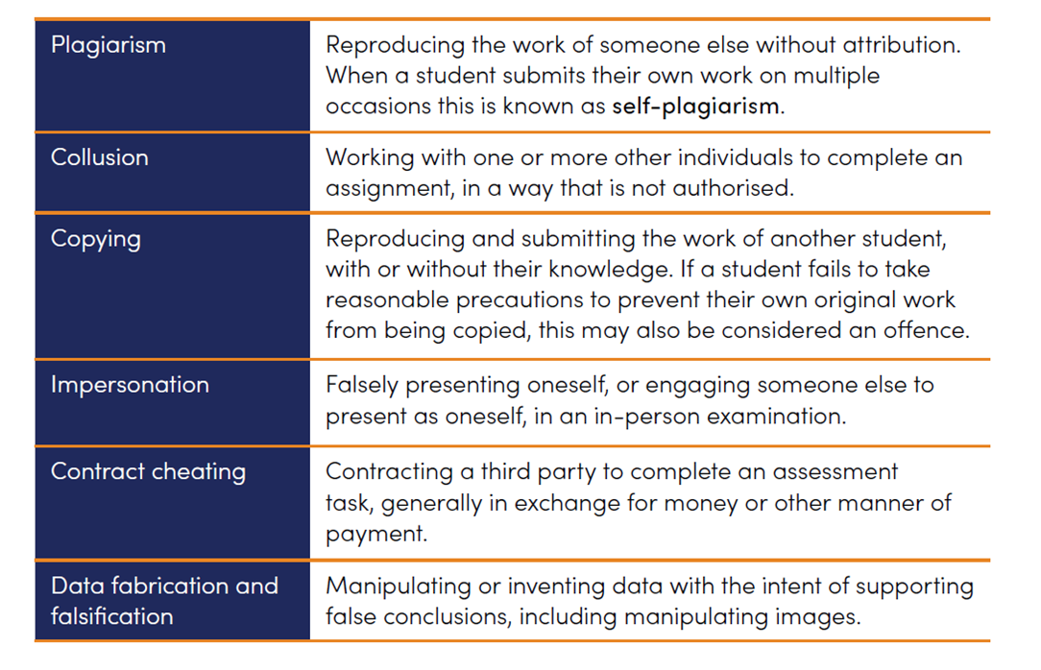
Academic Integrity
Academic Integrity is valued at UBSS.
Academic misconduct at UBSS is overseen by the ACADEMIC INTEGRITY COMMITTEE that will apply penalties and sanctions for misbehavior.
Please ensure you are familiar with the ACADEMIC MISCONDUCT POLICY located on the UBSS website: https://www.ubss.edu.au/policies-and-procedures
These are some forms of Academic Misconduct

Slide 53
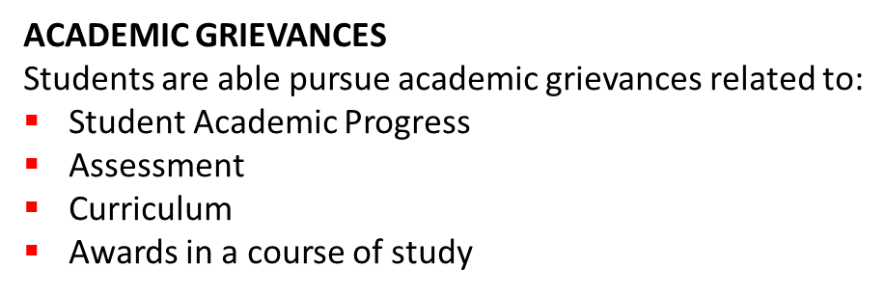
Policies and Procedures
You can find all UBSS Policies and Procedures on our website.
https://www.ubss.edu.au/policies-and-procedures

Slide 54
If you have any questions please contact Ms. Madilina Tresca
Madilina.Tresca@ubss.edu.au
Thank you and
Welcome to UBSS!!
Don’t forget to download your UBSS Mobile App and follow us on Social Media
www.ubss.edu.au

