Slide 1
STUDENT ORIENTATION
Trimester 3, 2018

Slide 2
1. IMPORTANT SAFETY INFORMATION

Slide 3
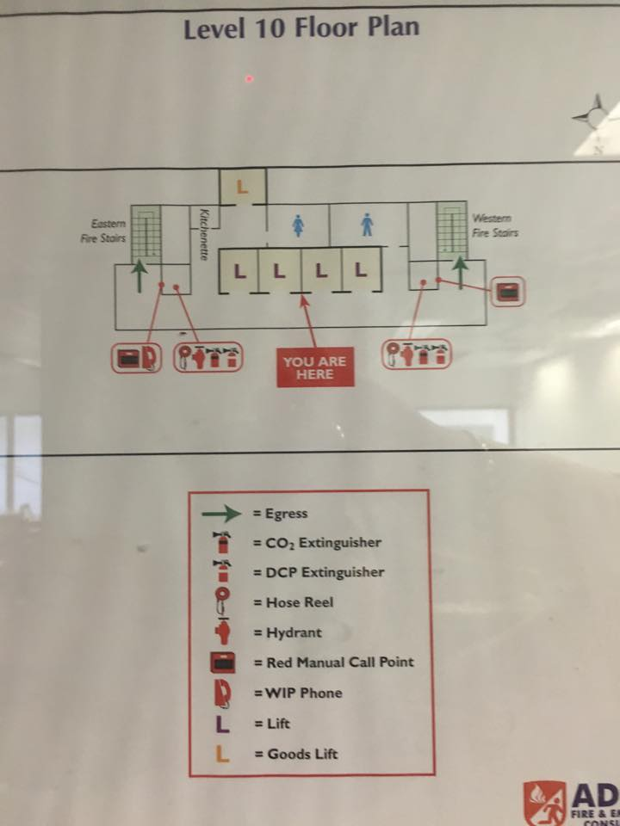
Evacuation Procedure
SAFETY @ THE COLLEGE
Evacuation Plans are posted on every floor near the lifts and in every room – make yourself familiar with them.
Levels 10 & 11, 233 Castlereagh St, Sydney

Slide 4
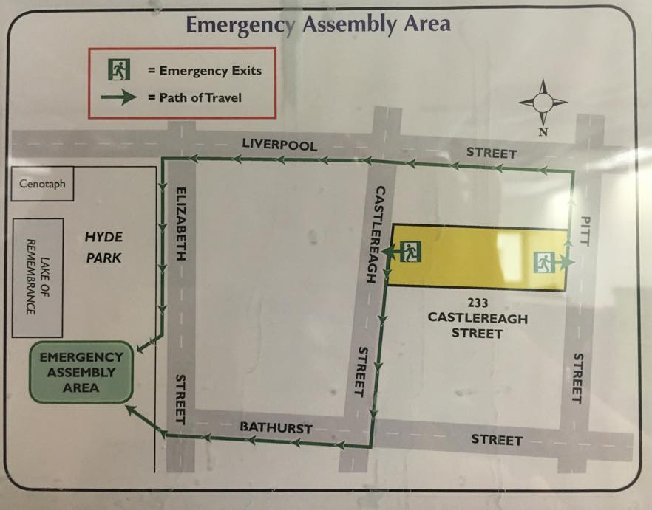
Evacuation Assembly Area
SAFETY @ THE COLLEGE

Slide 5
Emergency Contacts
SAFETY @ UBSS
Knowing how to call Triple Zero (000) is the quickest way to get the right resources from Emergency services to help you and should be used to contact Police, Fire or Ambulance services in life threatening or time critical situations.
Calls to Triple Zero (000) are FREE. For more information log into: www.fire.nsw.gov.au

Slide 6
First Aid
SAFETY @ THE COLLEGE
Senior First Aid Officers
Jotsana Roopram - Level 11
Sumera Qasim - Level 10
First Aid Kit Location Level 10 - Student Services
Level 11 - EDT office

Slide 7
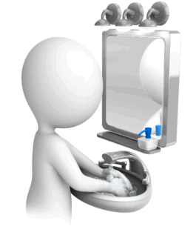
Hygiene on Campus
SAFETY @ THE COLLEGE

Slide 8
Hygiene on Campus
SAFETY @ THE COLLEGE
Students are to keep bathrooms clean & tidy. Consider others – clean up after yourself. Paper towel is to go in the bin provided.
MEN
Women
Sit
Use sanitary bins
Flush
Wash your hands
Aim in the bowl
Sit
Flush
Wash your hands

Slide 9
Hygiene on Campus
SAFETY @ THE COLLEGE
Student toilets are located on both floors Students are to keep bathrooms clean & tidy. Consider others – clean up after yourself. Paper towel is to go in the bin provided.
DO NOT squat on the toilets!

Slide 10
Hygiene on Campus
SAFETY @ THE COLLEGE
Students are to keep bathrooms clean & tidy. Consider others – clean up after yourself. Paper towel is to go in the bin provided.
Toilets can be DANGEROUS
If you squat!

Slide 11
Hygiene on Campus
SAFETY @ THE COLLEGE
Students are to keep bathrooms clean & tidy. Consider others – clean up after yourself. Paper towel is to go in the bin provided.
All sanitary items MUST go in the bins
provided.

Slide 12
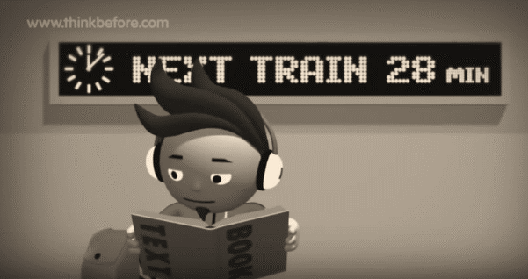
International Student Safety - Think Before

Slide 13
Security
Sydney is an international city (big)
SAFETY @ THE COLLEGE
Just like…..
Tokyo, Japan
London, United Kingdom
New York, USA
Kuala Lumpur, Malaysia
DO NOT leave your personal belongings unattended anywhere.
Beijing, China
Paris, France
Berlin, Germany
DO NOT tell strangers where you live.
BEWARE of theft.

Slide 14
Swimming Season
Most beaches are watched by lifeguards from September to April.
I will help you if you are in trouble in the water-
Just raise your hand!
Always swim between the flags!

Slide 15
Beach Safety Tips
Only swim between the flags
NO Flags = NO Swim!
Never swim alone or at night.
Never swim straight after eating
Never swim under the influence of drugs or alcohol.
DO NOT go rock fishing when waves are big- too dangerous

Slide 16
2. Academic Matters

Slide 17
The GCA Group
ABOUT US
Group Colleges Australia

Slide 18
Registration
ABOUT US
Tertiary education Quality and Standards Agency (TEQSA) is Australia’s regulatory and quality agency for higher education. All Higher Education Institutions, universities, and private colleges are registered with TEQSA.
Commonwealth Register of Institutions and Courses (CRICOS) for Overseas Students. All institutions approved to train overseas students on student visas are registered on this government register.
Fee Help is a loan scheme that assists eligible fee
paying students pay all or part of their tuition fees.

Slide 19
UBSS
ABOUT US
MOTTO
“Launch Your Career!”
VALUES
Academic Excellence & Free Intellectual Enquiry
Continuous Quality Improvement
Contribution to Professional Practice
Access & Equity

Slide 20
Our Programs
ABOUT US
Bachelor of Accounting has CPA and IPA Accreditation:
Professional recognition and equal status with university CPA and IPA accredited programs.
Bachelor of Business Majors:
Management, Human Resource Management, Marketing

Slide 21
Our Programs
ABOUT US
Master of Business Administration

Slide 22
UBSS Management
ABOUT US
GCA Board
UBSS
Academic Senate
UBSS
Notes:
UBSS and Metro are governed by the Academic Senate

Slide 23
UBSS Academic Senate
ABOUT US
To be the principal academic body of UBSS;
To oversee and coordinate the work of academic units and to evaluate and monitor the quality of teaching and scholarship;
To advise the GCA Board and Dean on matters relating to teaching and scholarship within UBSS;
To review education policy and provide advice and recommendations for the GCA Board;
Benchmark UBSS courses against similar courses nationally and internationally;
Meets 6 x per year

Slide 24
Key UBSS Academic Staff
ABOUT US
Associate Professor Wayne Smithson
Program Director
Bachelor of Accounting
Wayne.smithson@ubss.edu.au
Associate Professor Felix Stravens
Program Director
Bachelor of Business
Felix.stravens@ubss.edu.au
Professor Greg Whateley
Executive Dean
MBA
Greg.Whateley@ubss.edu.au
Professor Ray Hayek
Program Director
MBA
Ray.Hayek@ubss.edu.au
Notes:
Key Academic staff are your PD’s
GW, end of the hall, Level 11
RH, Level 10
Available by appointment only at the kiosk

Slide 25
UBSS Academic Staff
ABOUT US
UBSS lecturers have:
A Tertiary Degree at postgraduate level or equivalent;
At least 3 years of experience in Higher Education; and
Practical experience in business/accounting gained in the workplace
…to Launch Your Career
Notes:
Highly qualified staff and skilled staff
Our overall staff rating from our student satisfaction survey results for semester 1 and 2 this year have been 4.3 and 4.6 out of 5.
Which shows consistency with the teaching quality across all of our subjects.

Slide 26
UBSS Teaching Methods
GETTING
STARTED
UBSS provides…
A learner focused approach
Smart boards in all classrooms
Use of technology (computing applications, Moodle etc.)
Extensive e-Resource databases available on MyGCA
e-Resources: same as universities

Slide 27
4. UBSS Campus & Technology

Slide 28
MyGCA
OUR CAMPUS
& TECHNOLOGY
Online, 24 hour support
Comparable to universities where students can self manage their course using an web-based Student Management System
Student Services Online Features
Academic Certificates, Academic Progress Statement, Academic Results History, Academic Transcript, Appeal Application, Attendance, Change Password, CoE Change Request, CoE Request, CoE Review, College Information, Course Deferment, Request Course Extension, Disciplinary Action, Emergency Contact Enrolment, Confirmation, Feedback Form, Financial Status, Generate Offer Letter, Holiday Certificate, Journal, Leave Application, Policies and Procedures, Record Proof of Payment, Refund Request, Release Letter Request, Reset Student Password, Resit Exam Application, Resit Exam Timetable, Subject Exemption, Subject Selection, Student Card Replacement, Timetable

Slide 29
MyGCA
OUR CAMPUS
& TECHNOLOGY

Slide 30
Moodle
OUR CAMPUS
& TECHNOLOGY
Moodle was originally developed by Martin Dougiamas to help educators create online courses with a focus on interaction and collaborative construction of
content, and is in continual evolution. The first version of Moodle was released on
20 August 2002.
Learning platform allows material presented in classes to be viewed by student via Internet connection 24/7
There are 74,992 currently active sites that have registered from 227 countries.

Slide 31
Moodle
STUDENT
SERVICES
Moodle will give you access to:
Subject Outlines
Readings and recordings
Submission of assignments
Grades / Marks

Slide 32
e-Resources
OUR CAMPUS
& TECHNOLOGY
Access to thousands of publications via MyGCA.
EBSCO, ProQuest, Emerald, Oxford Reference, Informit and Gale Cengage Learning
Notes:
Accessed via myGCA

Slide 33
Wi-Fi
OUR CAMPUS
& TECHNOLOGY
We provide Wi-Fi On All Levels

Slide 34
GCA Computer Labs
OUR CAMPUS
& TECHNOLOGY
There is a Computer Lab on level 11 and e-resource room on level 10
When there are no classes in these rooms students can:
Access their myGCA account
Research and complete assignments
Surf the internet
Access emails and chat online

Slide 35
How We Communicate
Communication between GCA/UBSS and students is very important.
OUR CAMPUS
& TECHNOLOGY
Like all large educational institutions in Australia GCA uses technology to communicate with students
There are 5 main ways of communicating with you... 1)MyGCA bulletin
2)GCA Webmail 3)SMS to mobile 4)TV Monitors
5) Online Surveys

Slide 36
MyGCA Bulletins
OUR CAMPUS
& TECHNOLOGY
Bulletins are sent out so you don’t miss something important. MyGCA makes you open any new bulletin each time you log into your MyGCA account.
Once you have read the bulletin you can then access your MyGCA account.
The fact that you have seen and opened the bulletin is recorded in your Journal.
Old bulletins are archived so you can refer to them later if you need to.

Slide 37
Webmail
OUR CAMPUS
& TECHNOLOGY
All students have an email account:
XXXXXX@studentmail.groupcolleges.edu.au
One of the main forms of communication at GCA colleges is via EMAIL e.g. information about re-sit exams, academic progress warnings, excursion notices, emailing assignments, job opportunities, events

Slide 38
OUR CAMPUS
& TECHNOLOGY
SMS
Provide your mobile phone number via MyGCA and we will send you text messages
Text messages are very useful for urgent messages that we might need to send you.
For example changes to timetables, exams or excursions

Slide 39
Subject Surveys
OUR CAMPUS
& TECHNOLOGY
There are many reasons we administer a Student Survey:
To monitor subject content & lecturers’ performance
Student feedback on GCA
New students’ survey
General student satisfaction
Agent feedback
Intention of further study
All surveys completed online

Slide 40
3. Compliance with Immigration & Border Protection

Slide 41
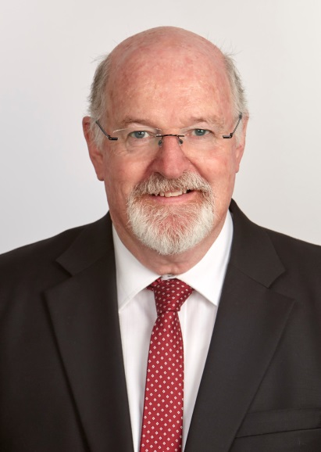
WELCOME
Professor Greg Whateley
UBSS Executive Dean
(02) 8332 2518
greg.whateley@ubss.edu.au

Slide 42
Compliance
COMPLIANCE
Compliance is…
Following Rules
Following Guidelines
legal requirement eg. Law of the Land, Drivers Licences, and Visas

Slide 43
Compliance (DIBP)
COMPLIANCE
DIBP deals with:
Issues student visas
Monitors students
DIBP is interested in:
Academic progress
Where you live (via your MyGCA account)
Age - Students under 18 must be living with a guardian.
Your employment
Group Colleges Australia and therefore UBSS have a legal responsibility to report students who do not meet the DIBP requirements
Notes:
Department of immigration and border patrol = deal with compliance

Slide 44
Compliance (You & DIBP)
COMPLIANCE
You choose to apply to the Australian government for a student visa and agree to follow certain rules & conditions to keep your visa
– this is called compliance
Students
Notes:
Why will you lose your VISA…

Slide 45
Compliance (Studying)
COMPLIANCE
To achieve Academic Progress you must pass over 50% of all your subjects
If you fail 50% of subjects taken in a trimester you will receive a detailed warning letter in your student email account.
Local students are also required to make academic progress
Failure in 2 consecutive trimesters of 50% of subjects will result in you being reported to DIBP for not complying with the Academic Progress requirement of your visa
Academic and non-academic intervention strategies are available to you. For more details refer to the Policies & Procedures document located on the UBSS website.
You have the right to appeal. For more details refer to the Policies & Procedures document located on the UBSS website - 3.14 Grievance Policy (Academic)
Check your progress in your MyGCA account
Notes:
Therefore…..

Slide 46
Compliance (Your Home)
COMPLIANCE
DIBP rules say Students must tell the college:
Where they live in Sydney
Their contact phone number
Up-date details within 7 days when they change
address
Students are able to change their contact details 24/7 online in their my GCA account student account

Slide 47
Compliance (Working)
COMPLIANCE
DIBP says if you have permission to work:
You can work a maximum of 40 hours per fortnight during the trimester
and unlimited hours only when your course is not in session.
Local Students do not have any restrictions on work
DIBP considers your course to be 'in session':
For the duration of the advertised trimesters (including periods when exams
are being held)
If you have completed your studies and your Confirmation of Enrolment is still in effect
If you are undertaking another course, during a break from your main course and the points will be credited to your main course.
Check the DIBP website form more info or visit a DIBP office to check if you have permission to work
http://www.immi.gov.au/students/students/working_while_studying/

Slide 48
Compliance (Working)
What are your rights at work?
Know your rights
There are some things you should find out from your employer as soon as possible. This includes:
your pay rate
whether you're full-time, part-time or casual (this affects your hours of work, pay rate and leave entitlements)
your hours of work
what your job duties will be
whether there’s an award or registered agreement that covers your job (this affects your pay rate, hours of work and other entitlements)
if there's a probation period for your job.
Know your responsibilities
You have responsibilities as an employee. These include performing the duties of your job, being punctual and reliable, and following any workplace policies, procedures, and health and safety rules.
A new job can give you a lot of opportunities - try to make the most of it. Check with your employer to see how you’re performing and look for ways to improve how you work.
For more information on your rights and responsibilities at work, visit the website:
https://www.fairwork.gov.au/find-help-for/young-workers-and-students

Slide 49
Compliance (You & DIBP)
COMPLIANCE
I will comply with all the rules
Student Visa Compliance Requirements
Laws of the Land
Academic Progress
Telling the college where you live
Working maximum of 40hrs/fortnight during session times
You remain Financial
I will comply
VISA
Students
Notes:
SUMMARY:

Slide 50
Compliance (You & DIBP)
COMPLIANCE
Just like you, Group Colleges Australia must comply with DIBP and Australian Government rules.
We agree to follow certain rules & conditions – this is called compliance
Licence for
International/ Domestic Students
Students

Slide 51
Compliance (You & DIBP)
COMPLIANCE
GCA has a legal responsibility to report students to DIBP if they:
▪Don’t make academic progress
▪If they change colleges
▪If they leave/stop attending
▪Cannot pay their fees
▪Do not give the college their current address and phone number
▪Change courses
Licence for
International/ Domestic Students
Students
Notes:
they…

Slide 52
Compliance (You & DIBP)
COMPLIANCE
Agents
DIBP
International Students
Educational
Institutions
Students
We all have to comply

Slide 53
Compliance (You & DIBP)
COMPLIANCE
Students must attend every class or they risk being reported to the DIBP
Notes:
BUT MORE IMPORTANTLY YOU MUST ATTEND CLASS to give yourself a chance of passing your subject!

Slide 54
5. Student Services

Slide 55
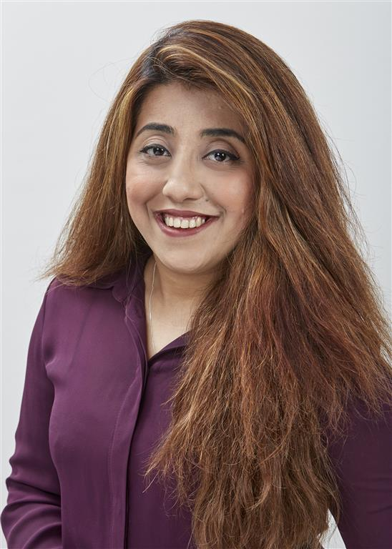
GCA Support Staff
ABOUT US
Sumera Qasim
Manager, Student Services
Sumera.Qasim@gca.edu.au

Slide 56
Student ID Cards
STUDENT
SERVICES
Student Identification
You must have your student card on you at all times.
If your card is lost, destroyed or stolen, replacement cards are available at the cost of $20AUD
Please apply online via MyGCA - Student Services Online under the Student Card Replacement tab to order your replacement card.
Your student number

Slide 57
Legal Assistance
Redfern Legal Centre
Free legal advice for International Students (https://rlc.org.au). To make an appointment call Redfern Legal Centre on 02 9698 7277.Your appointment can be held anywhere that you have access to a computer with internet and a webcam. All appointments are with a solicitor via webcam.
Services include:
Tenancy and Housing
Fines
Debts
Car accidents
Employment
Discrimination
Family Law
Domestic Violence
How legal issues can affect student visas

Slide 58
OSHC
STUDENT
SERVICES
Overseas Student Health Cover (OSHC)
OSHC is insurance to assist international students meet the costs of medical and hospital care that they may need while in Australia. OSHC will also pay limited benefits for pharmaceuticals and ambulance services.

Slide 59
OSHC
STUDENT
SERVICES
Overseas Student Health Cover (OSHC)
International Students must have health insurance/ Local students use Medicare
Once you have completed online student registration your information and money is sent to the health fund
It takes the health fund approx. 2-4 weeks to process your insurance
You will receive a message in your STUDENT EMAIL advising when card has been received.
Your card can be collected from Student Services on the Level 10
If you get sick before you get your card you can
still go to the doctor - you ARE covered - just keep the receipt and claim when your card arrives

Slide 60
Sickness
STUDENT
SERVICES
You need to see a doctor who is registered with the government (they must have a Medicare Provider Number) WHEN YOU ARE SICK
You need to ask the doctor to give you a medical certificate
You need to apply for the Medical leave via MyGCA under Leave Application and upload your medical certificate
MyGCA will give you medical attendance
You must keep the original of the medical certificate, as DIBP may wish to view this document.
Notes:
BUT this is important –
The doctor must be registered with Medicare provider

Slide 61
Refund & Cancellation
STUDENT
SERVICES
Need advice?
The refund and cancellation Policy is outlined in your Offer Letter.
For more details refer to the Student Refund Policy
located on the UBSS website

Slide 62
Counselling
STUDENT
SERVICES
I’m sad...
Need to talk – speak to a counsellor?
If you are having personal problems & you need to speak to someone, GCA can help.
The Sydney University Psychology Clinic Door 3 - Mackie Building
2 Arundel St Forest Lodge
University of Sydney NSW 2006
Tel: (02) 9351-2629
Ask reception for more information
Small fee (approx. $20 per hour) is payable
direct to the Clinic
Notes:
Our affiliated counselling clinic is located in Forest Lodge, which is a short bus trip north of the cbd $20

Slide 63
Holidays
STUDENT
SERVICES
Holidays can ONLY be taken during college breaks (when the trimester and all exams have finished)
You must be back from your holiday
for your
first class at college this may impact your
otherwise
academic progress
No attendance is given if you take a
holiday during trimester time
If you do not attend a class during trimester time the student is responsible for any missed assessments, not the lecturer
Notes:
Please check calendar dates on UBSS website

Slide 64
Paying Your Fees
STUDENT
SERVICES
Credit Card on-line via MyGCA
An invoice can be printed from your MyGCA account.

Slide 65
Paying Your Fees
At education institutions around the world……
You must remain Financial at all times
If you do not pay your fees....
You will not have access to your MyGCA account
You will not have access to your online course materials on Moodle
You cannot attend classes or take exams
You cannot attend classes or take exams
You will not be able to fulfil academic progress
You may be discontinued from the College and DIBP would be informed
You may be reported to debt collectors

Slide 66
6. Getting Started

Slide 67
Student Representative Committee
GETTING
STARTED
UBSS Business Society
To act as a central contact body/liaison point between UBSS management and the student body
To provide constructive feedback on behalf of the student body on the student experience to UBSS management

Slide 68
Subject Selection
GETTING
STARTED
Log into your
myGCA
account today and
select your subjects
If you don’t know what subjects to choose – check the UBSS website (Courses Section)
Select EARLY – subjects may fill-up quickly!

Slide 69
Study Load & Progress
GETTING
STARTED
International students must be enrolled FULL-TIME
FULL-TIME enrolment = completing 8 subjects in 1 year
If you do not study full-time you will not finish within your CoE period. You need permission & valid reasons (e.g.: medical) to study less than 8 subjects per year
Study Load Rules and examples are on the UBSS website:
http://www.ubss.edu.au/Content.aspx?pid=162
You must make Academic Progress = passing 50% of your subjects (or ¾ subjects) every trimester. Info avail at:
http://www.ubss.edu.au/Content.aspx?pid=162
Notes:
And you need to get permission now – please see Student Services who will point you in the right direction

Slide 70
2018 Trimester Dates
GETTING
STARTED
UBSS offers three trimesters each year:
Teaching Week 1, 2017 (Starts January 22):
12 teaching weeks
Teaching Week 2, 2017 (Starts May 14) :
12 teaching weeks
Teaching Week 3, 2017 (Starts September 3):
12 teaching weeks

Slide 71
Attendance
GETTING
STARTED
In order to meet the ACADEMIC PROGRESS requirements
we strongly suggest that you attend 100% of your classes.
Your attendance cannot be recorded if you do not have your Student Card
There is an attendance scanner just inside the door of every GCA classroom
If you forget to swipe your card your attendance will not be recorded for that lesson
You must not give your card to anyone else - especially for the purposes of attempting to gain attendance by fraud
Doing well and passing subjects is important….and it is a DIBP requirement for your visa

Slide 72
Study Skills
All new UBSS students are taught study skills, including academic writing in the Advanced Business Communication subject, which is compulsory in your first trimester.
Every trimester, the Learning Support Coordinator holds a number of workshops for undergraduate and postgraduate students specific to the following topics:
Employability skills workshops
Academic literacy skills workshops
Research skills workshops

Slide 73
Online Bookshop
GETTING
STARTED
Some UBSS textbooks are available electronically at the Co- Op Bookstore through the GCA Account at a cheaper rate than hard-copy textbooks
All subject textbooks are available to purchase online and will be delivered direct to your home address in Australia.
Simply .....
Logon to the website
Select the textbook
Proceed to the checkout
Pay and enter your delivery
address
http://www.ubss.edu.au/Content.aspx?pid=117
Notes:
Every subject has a prescribed textbook.

Slide 74
Pathways
GETTING
STARTED
Central College has an articulation agreement with UBSS enabling students who successfully complete:
Advanced Diplomas and
Diploma Courses
Entry into related Bachelor Degrees with up to 10 subject credits for Advanced Diplomas and up to 7 subject credits for Diplomas.
Unrelated Courses will not attract the same level of credit

Slide 75
Credit Transfer
GETTING
STARTED
What is credit transfer?
Credit Transfer is where you receive recognition for previous study where that study is the same as the course you are going to be doing.
To be eligible for credit transfer of study from another institution, conditions need to be met. The previous study must have:
Same/Similar Content
Same/Similar Duration
Same/Similar level of institution, i.e. higher education/university or vocational education at appropriate level of study
Application must be made during the beginning of first trimester of study.
Granting of exemptions for courses that are UNRELATED to the course for which you are enrolled will not receive the same amount of exemptions as a related course.
Credits are granted for students from external organisations on an
individual basis, based on the Credit Transfer Policy. For more details refer to the Policies & Procedures document located on the UBSS website
3.8 Credit Transfer Policy

Slide 76
7. UBSS Policies & Procedures

Slide 77
College Code of Conduct
UBSS POLICIES & PROCEDURES
The Code of Conduct is the Standard of behaviour UBSS expects of everyone.
The college reserves the right to suspend or expel any student who in any way breaches the College Code of Conduct or any of the associated College Rules.
A copy of the College Code of Conduct can be found by on the UBSS Website www.ubss.edu.au and clicking on the ‘Policy & Procedures‘ tab. For more details refer to the Policies & Procedures document 2.1 Code of Conduct

Slide 78
Academic Grievances
UBSS POLICIES & PROCEDURES
To provide a procedure that enables all students to pursue academic grievances related to:
Student Academic Progress
Assessment
Curriculum
Awards in a course of study
A copy of the Academic Grievance Policy can be found by on the UBSS Website www.ubss.edu.au and clicking on the ‘Policy & Procedures‘ tab. For more details refer to the Policies & Procedures document - 3.13 Grievance Policy (Academic)
Note: A concern relating to assessment marks, curriculum outlines and awards must be initiated within 20 days from the published date.

Slide 79
Plagiarism/Cheating
UBSS POLICIES & PROCEDURES
Examples
If you copy the work of others
You are plagiarising if you copy from the internet or a book and do not reference appropriately
Asking another person to write an assessment item
Summarising and paraphrasing another's work without acknowledging the source.
The Harvard Referencing system will be taught as part of the compulsory Advanced Business Communications subject
For more information on Plagiarism and Penalties, read the UBSS Policies and Procedures document

Slide 80
8. Life on Campus

Slide 81
Genuine Students
LIFE ON CAMPUS
UBSS considers genuine students are those that are:
On time to class
Prepared for their classes – that is they have books, notepaper, pens and have done any pre- reading required
Listening and actively taking notes in class
Completing all set assessments and readings
Asking questions if they don’t understand
Completing tasks and assessments to the best of their abilities and doing their own research and work

Slide 82
Assessments
LIFE ON CAMPUS
Every subject has assessments you must complete
The number and types of assessments will vary from subject to subject. 3 assessments is standard for each subject
4 subjects = 12 assessment items in one trimester!
Assessments can include tests, essays, quizzes, exams, projects, group work and presentations
UBSS have two official mid trimester tests and a final exam scheduled every trimester.

Slide 83
Awards & Prizes
LIFE ON CAMPUS
UBSS recognises and rewards academic excellence for hard working students. 2x types of prizes available:
1. Prof Gus Guthrie Award for Outstanding Academic Achievement (at graduation at the end of your course)
2. UBSS Awards for Academic Excellence (by Subject)

Slide 84
9. What’s Next?

